Slide 1


YELP Data Analysis using HIVE
CIS 5200
Professor Jongwook Woo
Submitted By: (Team 2)
Philip Wong
Pratiksha Yadav
Pooja Madhup
Shailja Pandit

Slide 2

GOALS
Provide a high level, general, and aggregated approach to sentiment analysis. Visualize the results to find insights.
Overall sentiment of yelp users (yelpers) and behaviors
Healthcare and Food/Beverage category
What insights can we obtain for the US healthcare system?
What does the data show towards food establishments across the country?

Slide 3
YELP INTRODUCTION
Yelp is an internet-based company that focuses on crowd-sourced review system for millions of businesses and establishments across the US and globally.
Yelp users can submit feedback in terms of reviews, ratings, and list information pertaining to the establishment.
The yelp data set and will include three Json files (Business, User, and Reviews) which we will join with the dictionary dataset required for sentiment analysis.

Slide 4
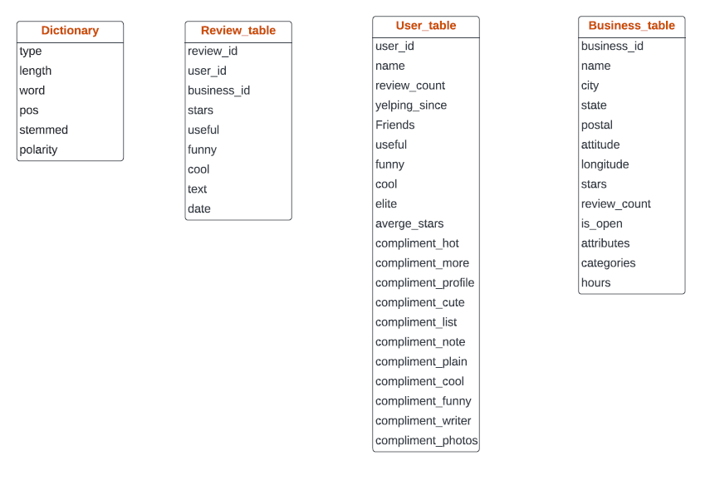
TABLE REFERENCE DIAGRAM

Slide 5
DATASET INFO
DATASET NAME: Yelp Dataset
DATASET URL:​ https://www.yelp.com/dataset/download
TOTAL SIZE:​​ 8.21 GB
COUNTRIES CONSIDERED: USA and World
NUMBER OF FILES: 3
FILE FORMAT:​ JSON, CSV
GIT HUB LINK: https://github.com/pooja9050/Yelp-Data-Analysis-Using-Hive

Slide 6
HADOOP CLUSTER SPECIFICATIONS
VERSION:​ 3.2.1-amzn-3.1
TOTAL NODES:​ 4
TOTAL NODE MEMORY SIZE:​ 0-7 / 30874 KB
TOTAL NUMBER OF CPUS:​ 4
TOTAL STORAGE:​ 481GB

Slide 7






ARCHITECTURE workflow
Data Source
Download Dataset
Upload data into HDFS
Data Warehousing
Data Manipulation
Visualizations
Find insights

Slide 8
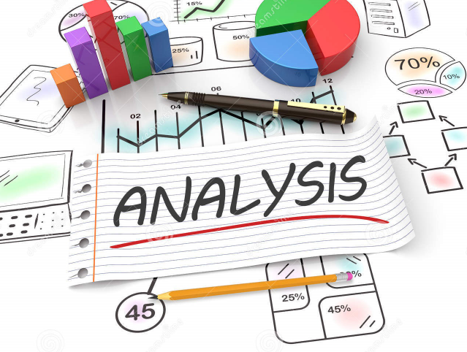

Slide 9
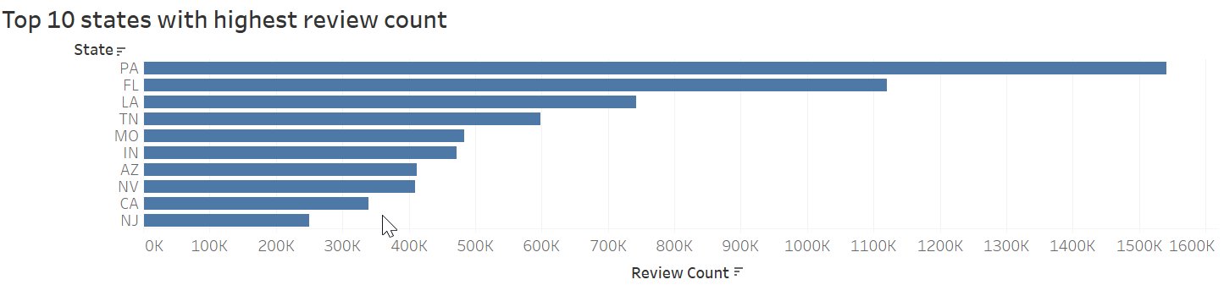
Top 10 states with THE highest review count
Insights
The maximum review count is observed in Pennsylvania of 1.52 million.
Followed by Florida, Louisiana, Tennessee as observed in the graph.

Slide 10
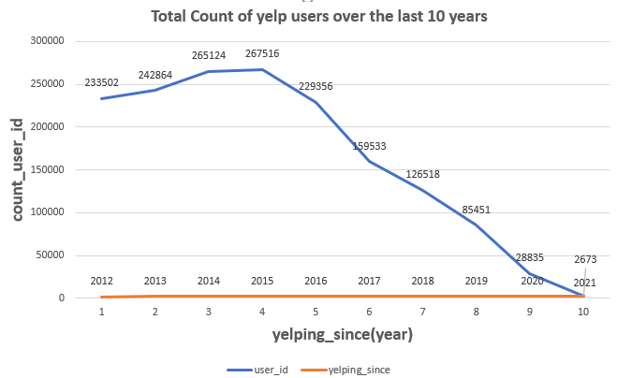
total count of yelp users for last 10 years
Insights
The visual data shows in which year yelp had peaked users using yelp app or yelp.com to post their reviews.
Yelp got maximum number of users in 2015 and from 2016 the count of users is declining.

Slide 11
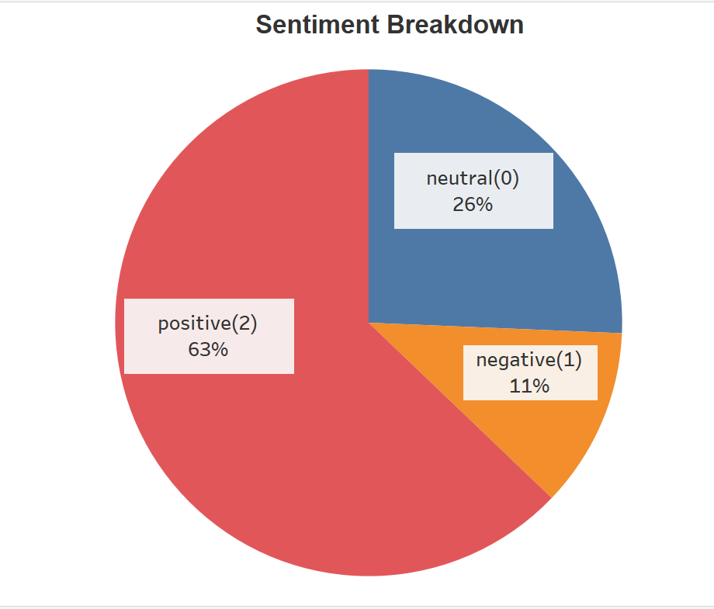
YELP HOSPITAL SENTIMENT
Analysis & Conclusion
Key Findings:
Overall city-wide sentiment breakdown is:
63% Positive, negative 11%, neutral 26%
Most cities overall conform to this trend with low variance
Insights:
From this pie chart, we find that most of the yelp users have positive sentiment about the hospital category meaning they are overall satisfied in terms of hospital in USA

Slide 12
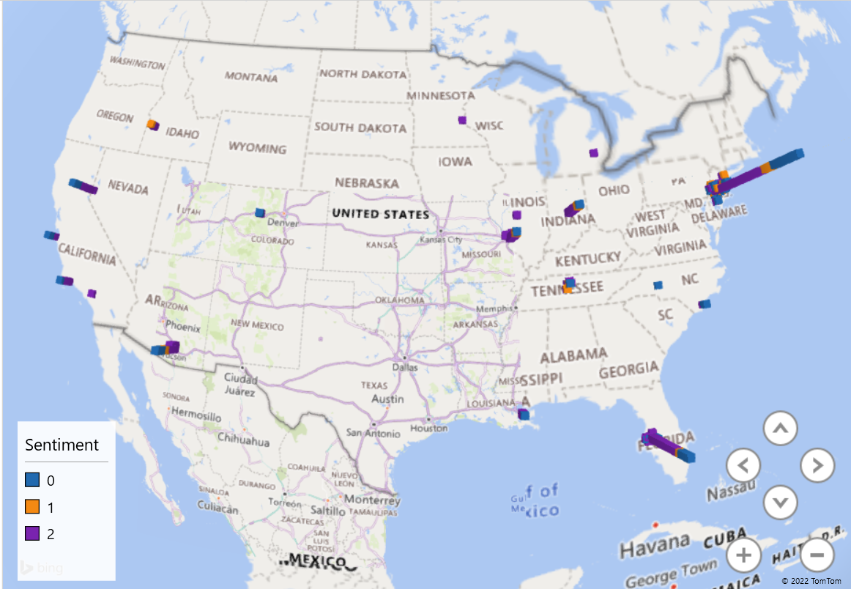
Total yelpers using hospital as category in yelp for different cities in USA
Insights
In this geographical map , we observed that most of the yelp users in North-East region have the positive sentiment for hospitals.
Hospital users in Philadelphia are more as compared to other cities in America.

Slide 13
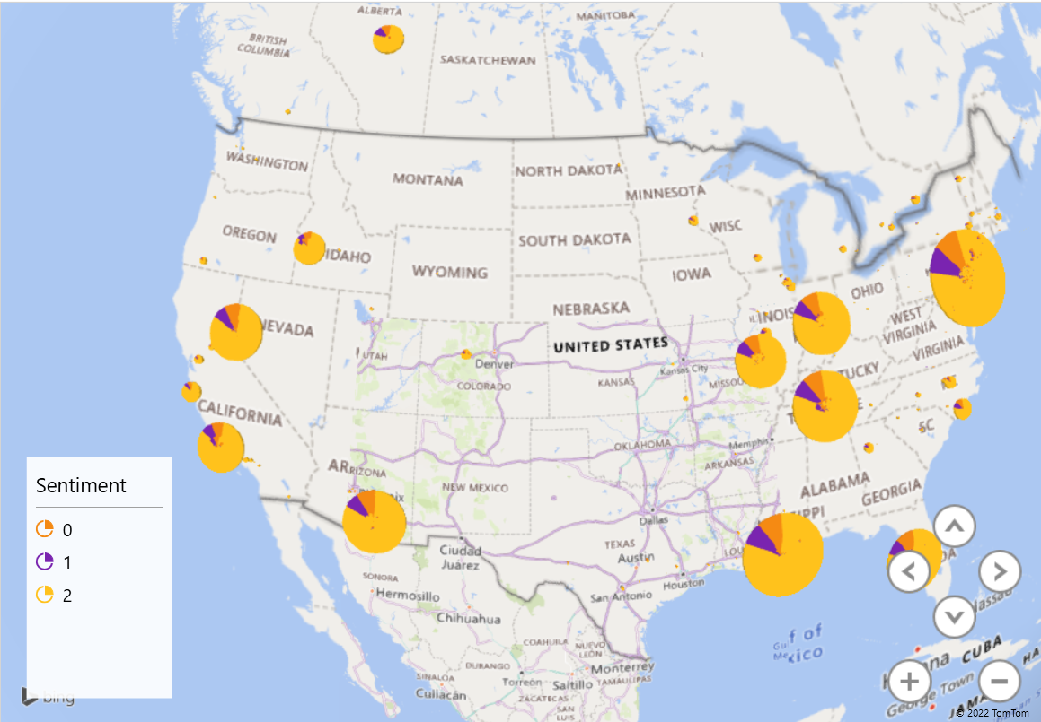
Sentiment of Restaurants BY City
Insights
Sentiment is very consistent throughout the country. Overall positive sentiment.
We have the most restaurant reviewers in Philadelphia than any other part of country.
Notes:
More than 2 million records by city. 2/3 of the data presented
Issue with displaying all data through power-map.
-

Slide 14
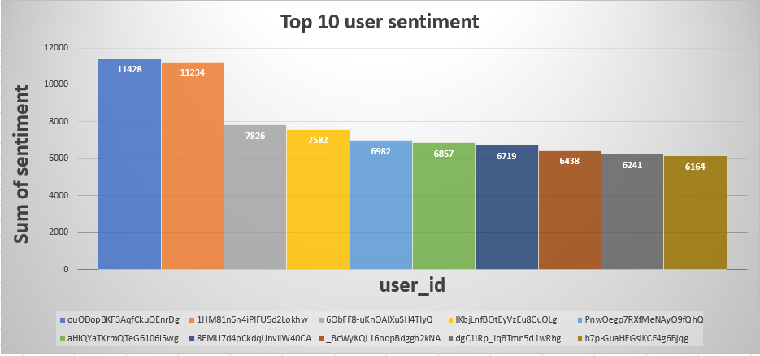
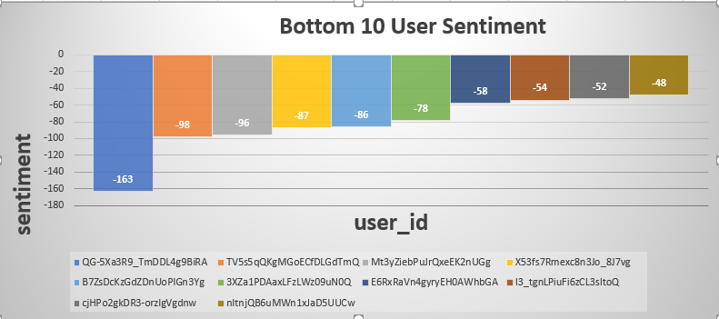
Aggregated Sentiment by USER
Insights
When users' polarity was positive it was extremely positive.
Negative polarity users were generally a bit more
The Average/Mean polarity was +16.
Notes:
Sentiment by WORD -> SENTENCE -> REVIEW -> Finallly Group by USER.
Then we filtered ASCENDING/DESIGNED LIMIT 10.
So-called “NET” polarity
Average was about 16.

Slide 15
CONCLUSION
This information is invaluable for the business as they can improve their product/service quality for no cost.
This analysis provides stronger evidence versus for example anecdotal evidence.

Slide 16
THANK YOU!

